Slide 1
IMAGE SLIDER
Adhiyamaan college of engineering
DHANU SHRI .J

Slide 2
Introduction
Purpose of the Project:
The purpose of this project is to create a functional and visually appealing image slider for a website. The slider will allow users to navigate through a series of images using navigation buttons or automatic transitions.

Slide 3
Project Overview:
This project involves developing a simple image slider using HTML, CSS, and JavaScript. The slider will be responsive and will include features such as automatic sliding, navigation buttons, and image captions.

Slide 4
Project Requirements:
Create a container element to hold the images.
Add images to the container element.
Create navigation buttons (previous and next) to navigate through the images.
Create a pause/play button to control the slideshow.
Implement the slideshow functionality using JavaScript.

Slide 5
Software and Technical Tools:
Software and Tools Used:
Text Editor (e.g., VS Code, Sublime Text).
Web Browser (e.g., Chrome, Firefox).
Technical Requirements:
Basic knowledge of HTML, CSS, and JavaScript.
Images for the slide.

Slide 6
Implementation :
Setting up the project structure.
Adding HTML for the slider.
Styling the slider with CSS.
Adding JavaScript for functionality.
Testing and debugging .

Slide 7
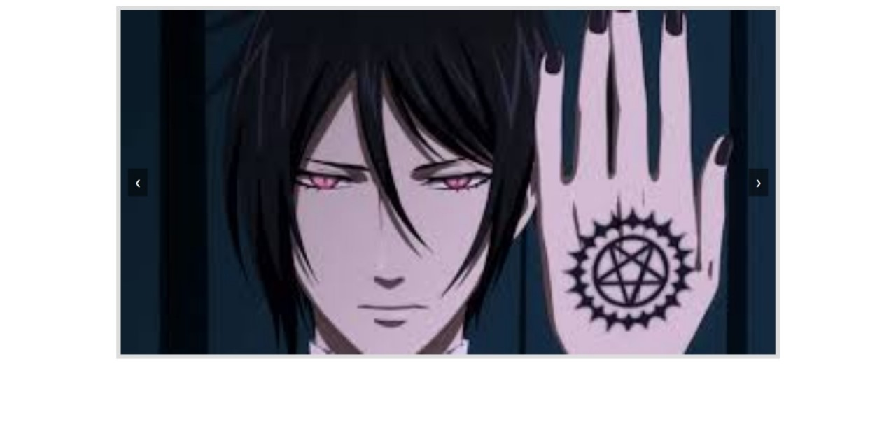


Slide 8
Conclusion:
This project successfully developed a basic image slider using HTML, CSS, and JavaScript. The slider is responsive, supports automatic transitions, and includes navigation buttons for user control.

